Slide 1
Essais de convivialité
(avec une pincée d’AGILITÉ)

Slide 2
Pour commencer

Slide 3
Définir la convivialité (facilité d’utilisation)
« Mesure dans laquelle un produit peut être utilisé par des utilisateurs spécifiés dans le but d’atteindre des objectifs précis et ce, de façon efficace, efficiente et satisfaisante dans un contexte d’utilisation précis »
- ISO 9241-11
Notes:
Source: International Organization for Standardization (ISO) 9241-11 Ergonomics of human-system interaction (https://www.iso.org/obp/ui/#iso:std:iso:9241:-11:ed-2:v1:en)
Effectiveness – ability for users to complete tasks accurately
Efficiency – the amount of time (or other resources) that the user has to employ in completing a task
Satisfaction – how happy the user is with the interaction

Slide 4


Types de problèmes sur lesquels nous nous concentrons généralement
SIMPLE DÉFINISSABLE ET PRÉVISIBLE
COMPLEXE DIFFICILE À DÉFINIR ET IMPRÉVISIBLE
Notes:
Tame Problems:
Good agreement on problem definition
Linear approaches work well
Causality is easier to arrive to
Wicked Problems:
No agreement on problem
Difficult to predict
Difficult to determine cause and effect

Slide 5

Pourquoi nous nous préoccupons de l’expérience utilisateur (UX)
Remédier aux lacunes et aux problèmes en matière de convivialité
Aborder les questions soulevées durant le parcours de l’utilisateur
Y réfléchir à fond
Tenir compte du contexte d’utilisation
Maximiser la valeur pour les utilisateurs
Notes:
At the end of the day, in our context, I have found it easiest to think about it in terms of addressing the gaps and disconnects between users and their abilities to perform tasks to achieve objectives with your products and services.
We also do UX to address problems that may occur during a person’s journey towards accomplishing a task with your product or service.
So, when we think about usability, were need to think it all the way though. This means that sometimes there will be problems that you will need to address, or at least consider, in terms of what is happening before your product or service becomes part of their journey, or after.
This is important, because for the most part, anything we produce is part of an ecosystem. Which means that there are things that may affect a person’s mindset while engaging with your product or service.
In other words, make sure your stuff provides value to them by being easy to use. Otherwise, they will probably start using someone else’s stuff.

Slide 6

Parlons-en : des expériences non mémorables
Donnez quelques exemples d’expériences non mémorables pour les utilisateurs.
En voici une : les guichets automatiques
Notes:
DISCUSSION: Let’s think about interactions with product or services that are so good that they’re not even memorable.

Slide 7
Les 3 questions de la recherche sur l’expérience utilisateur
Qui?
Quoi?
Est-ce que ça fonctionne?

Slide 8
Types de données produites
qualitatives
quantitatives

Slide 9
Essai de convivialité – ce que c’est, ce que ce n’est pas
Vérifier si ça fonctionne
Avez-vous livré ce que vous aviez annoncé?
Notes:
What it is, what it is not
Usability testing is whether the thing is usable.
It’s essentially us making sure that what we made is usable in the sense that it enables users to complete tasks in the context of the product and/or service that we have built.
It is NOT user acceptance testing (UAT). UAT is checking to see whether we delivered the things we said we were going to deliver, as in the requirements we said we would deliver.

Slide 10
Mise en contexte des essais de convivialité

Slide 11
Alors, où se situent les essais de convivialité dans le processus de l’UX?

Slide 12
DÉCOUVRIR
DÉFINIR
APPROFONDIR
EXÉCUTER
Comment les utilisateurs résolvent-ils le problème maintenant?
Les besoins de l’utilisateur sur lesquels nous nous concentrerons
Créer des prototypes de solutions
Essais avec les utilisateurs finaux et l’organisation

Slide 13

Auditoires et problèmes – Pour qui, pour quoi?
À qui s’adresse votre produit/service?
Que savez-vous à leur sujet?
Quels sont les problèmes que vous traitez pour eux?
Soyez un détective, pas un touriste.
À quoi ressemble leur contexte d’utilisation?
Notes:
Who was your product or service designed for?
PRO-TIP: We are rarely our own target audience.
Are you sure you have identified the right audiences for your product or service?
What do you know about them? What they care about? What their environments are like?
Be a good detective and find these things out. Talk to some people and find out what their environments are like, what does their space look like? Sound like? Is it bright or dark? Noisy or quiet?
Avoid doing all your UX design and testing in a controlled environment. When you go see a puma in the zoo, you will not see actual puma behaviour. You will see puma in a zoo behaviour, but this will not really tell you much about how a puma interacts with its environment.
It’s the same for people. When they come to you into controlled environments, you are not necessarily seeing them in their natural environments, so you may miss clues or nuances that may greatly affect how they interact with your product or service.
Are you sure you have identified all of them?
This is an important part because it will help you in terms of making sure that you have the right proper testing your product/service for usability. They are who you are building this for, so they should be who you are testing with.

Slide 14
Parlons-en : Les essais de convivialité sont-ils toujours appropriés?
Scénario : Vous entendez dire que certaines personnes ont des problèmes de convivialité avec votre site. Vous regardez les analyses et constatez un déclin dans la consultation de certaines pages. Que faites-vous?
Notes:
Let’s talk through this scenario.

Slide 15
Parlons-en : Les essais de convivialité sont-ils toujours appropriés?
Trianguler le problème
Quand vous entendez des battements de sabots, ne pensez pas à des zèbres
Posez les bonnes questions
Qu’est-ce qui vient avant/après?
Qu’est-ce qui fait partie du contexte et/ou de l’écosystème de l’expérience?
Notes:
Triangulate
Your first step should always be to try to triangulate the issue with more data points to make sure that you are not misunderstanding the root causes.
If your first instinct is to run some baseline usability testing, you may be missing the root cause.
If the issue is with network infrastructure, then you may not know this from doing usability testing in a controlled environment.
Asking the right questions
When you hear hoofbeats, think horses, not zebras.
This means that look for the most obvious explanations first. If the data (qualitative and quantitative still doesn’t make sense, then you can start considering more exotic causes for the problem. Otherwise, you may tend to overthink and over-engineer the problem and your approach to a solution.
Ask the right questions
Think about things like:
what comes before the problem is experienced and what comes after?
What else is part of the experience chain that may be the cause or contributor to the problem being experienced?
What parts of this are under your influence and/or control? And who in your ecosystem had more influence/control thank you do? And are they aware of the issue and the impact it has on the people being affected by it?

Slide 16
Comprendre vos réalités

Slide 17

Comprendre vos réalités – l’expérience utilisateur où vous êtes
À quoi ressemblent les essais de convivialité à l’endroit où vous êtes?
Qui est concerné?
Quand et comment sont-ils faits?
Notes:
What does usability testing look like where you are?
Who is at the table when planning, approving, executing, analyzing, decision-making?
When is it done?
How is it done?

Slide 18
Types d’essais
Notes:
There are mainly 3 types of testing that we talk about.
Low fidelity
Medium Fidelity
High Fidelity
Before we start to talk about the types of testing though, let me talk to you about proposing your testing and communicating the recommendations.

Slide 19

Types d’essais – Basse fidélité
Niveau stratégique
Exemples : Séances de sollicitation rapide, visites structurelles et discussions
Validation de la vision, de la direction et de l’audience de la conception
Valeur : valider ce que nous savons par rapport aux conceptions initiales et itérer de manière rapide et économique.
Notes:
I usually refer to this as strategic level ux because at this level we are thinking through concepts with users.
Example: Rapid Elicitation sessions, wireframe walk-throughs and discussions with a group of 4-8 people
You start with identifying the problem as you understand it currently and its context, while engaging in a brief discussion to validate with the group
Think of this a testing the vision of your solution/approach at a high level.
This will provide mostly qualitative data.
This will typically answer questions like:
Are you heading in the right direction?
Are you considering the right things?
Are you talking to the right people?
Do you have the right information to move forward?
The value of this is that we are validating what we know against initial design assumptions in a way that is quick and cheap to iterate and refine the approach to the solution.

Slide 20


Types d’essais – Fidélité moyenne
Niveau tactique
Exemples : Essais de convivialité modérés, essais de premier-clic
Mettre à l’essai les hypothèses de conception, chercher les tendances en matière d’utilisation (+/-)
Valeur : valider les hypothèses de conception de façon plus détaillée.
Notes:
Tactical level UX
Example: Moderated usability testing
Individual: one on one with participant and researcher, plus one or two note takers. This is best done remotely to avoid observer bias.
Clickable Mockups (or sometimes wireframes) with people performing set tasks through moderated means and then discussing the experience.
You can also use online tools such as Optimal Workshop’s Chalkmark to have them point to where they would click to complete a task. This will provide more quantitative data that you can use to compare to moderated testing data and look for areas of discord to follow up on.
You observe a person as they try to complete specific tasks, and then discuss their experience.
Is your design appropriate and relevant to the people you are making it for?
Is it helping them address their issues?
Is it improving their efficiency, effectiveness and satisfaction with the process of completing their tasks, and ultimately your product/service?
Value: Validate design assumptions with a more tangible product with users to start to gather information about how they interact with the product/service in more detail.
Testing here is also good because it is still quick and cheap to iterate and correct things. Especially when you realize that you have missed an important piece or that design assumptions you had made are less valid than you thought.
Usually produces more quantitative data, although some quantitative data can be produced as well.

Slide 21

Types d’essais – Haute fidélité
Aussi au niveau tactique
Exemples : Essais en ligne à rythme libre
Mettre à l’essai les hypothèses de conception, chercher les tendances en matière d’utilisation (+/-)
Valeur : Peaufiner la conception en termes d’interactions, de flux, d’étiquettes, etc., mais en contexte réel.
Notes:
This is also tactical level UX
Watching users doing through concepts
Example: Online self-paced using tools such as hot jar to view heat maps of where they click
You can either present users with tasks for them to try to complete and ask them survey-style questions in the tool after, or you can just let them look around and pop up sentiment questions (“How did you feel about...”, “What did you think of...”), pop-up kiosks allowing people to complete certain tasks as well as exploring at will while you observe and ask questions after. Also, this can be part of continuous testing in terms of tools such as hotjar, or tied to certain KPIs as part of your analytics. So, if a KPI falls under a certain pre-established tolerance level, it can prompt you to go do some research to find out why that is happening.
By the time you get here, you want to be doing minor changes to your usability. This is not to say that you will never come upon that edge case that nobody caught and have to go back and rework a bunch of things. It just means that if you have iterated properly through the first two levels, the likelihood that you will have missed something is greatly diminished.
Value: Further fine-tuning of interactions, flow, labels, etc, but in a live context.
Usually produces more quantitative data

Slide 22
Cette pincée d’AGILITÉ

Slide 23

Cette pincée d’AGILITÉ – Cas d’utilisation ET témoignages d’utilisateurs
Schéma descriptif des exigences
Cas d’utilisation
C’est le comportement du système, selon ce qu’il doit permettre à l’utilisateur
Récit de l’utilisateur
C’est ce que l’utilisateur veut/doit accomplir à l’aide de système
Notes:
OK, so before we get into the definitions, you need to know that there is often a difference of opinion about which is which, but in the UX and Business Analysis world, we tend to use these definitions. So, if you’re going to be working with IT on your project and sharing your story map, you will want to make sure you agree on a definition before you start.
Typically in an agile environment you will gather your requirements and distil them into a story map that is broken down by use cases and user stories. This is useful because through your initial engagement sessions with business stakeholders and users you will get a lot of feedback that can be aggregated into more easily actionable use cases and user stories.
An example of a use case would be. “Browse our Catalog”.
An example of a user story would be, “I want to be able to add a product to a wish list so I can come back to it later”.

Slide 24
Cette pincée d’AGILITÉ – établissement des priorités et planification
Établissement des priorités
Rouge/Vert + MoSCoW
Travail accumulé
Sprint de planification
Notes:
Now that you have your use cases and user stories, you need to look at prioritizing them. The two ways of doing this that I prefer are the Red/Green and MoSCoW exercises.
Both of these will mean sitting in a room with your story map, and the people that you would have identified in your project charter as part of your decision-making governance team. If you don’t happen to have that, make sure that you have your project manager, and people from dev and design, as well as someone from policy to tell you when something is mandatory or a no-go.
In a red/green exercise, you go through each user story and people vote with a red or green card in terms of saying yes or no to it. This one is quicker.
A MoSCoW exercise is a little more involved because you identify things as: Must do right now; Should do; Could do; and Won’t do right now (or ever).
What comes out of this is a prioritized backlog. The backlog is essentially your to-do list.
You will use this to-do list to pick from when you are planning your sprints. A sprint is basically a short period of time, typically between 1-3 weeks, in which you are quickly completing design, development and testing of a set of user stories from your backlog.
The trick is to pick the right amount of things to do in a sprint so that you can get them all done. Just remember that not all user stories are created equal, so some may take more to implement than others, depending on their dependencies on other parts of your project.

Slide 25
Stratégie de mise à l’essai

Slide 26

Stratégie de mise à l’essai
Objectif
Méthodologie
Mesures
Produits livrables
Notes:
Your testing strategy will help you create a high-level vision for your testing. This will include the objectives for your testing, the types of testing methods, metrics, and deliverables.
This will be very useful to ensure that you have alignment with your objective to overall project objectives, as well as transparency around your methodologies. In addition, communicating the metrics you’re after and the deliverables for your research will provide some legitimacy to your work in your organization by being explicit about the value you are providing.

Slide 27
séquence d’essai de convivialité typique

Slide 28
séquence d’essai de convivialité typique
Planification et logistique
Exécution (sprints)
Analyse
Recommandations
Notes:
Assuming that you have This is what a typical testing sequence looks like. Now, let’s unpack the different steps.

Slide 29
séquence d’essai de convivialité typique – Planification et logistique
Scripts d’essai
Résumés d’activités
Question de recherche
Cas/récit d’utilisation
Tâches de l’utilisateur
Questions de suivi
Méthodes
Logistique
Consentement éclairé
Notes:
Now that you have your testing strategy, the first step is planning and logistics. This is made up of Activity Briefs, and your Testing Scripts.
Once you have your strategy, this will free you up to use activity briefs to do your operational planning and logistics. This means identifying your research question for what you’re testing, methods for testing, use case and associated user stories, and logistics in terms of who, when, and where. Best of all, you can do this in one page, 2 maximum.
Finally, you develop your testing script. Here you get to develop the appropriate user tasks and follow-up that will enable you to gather answers and insights to your research question. Also, don’t forget to include an introduction to what you’re doing, the types of information you will be gathering and how you will be doing it. Informed consent is important in research with people, especially if you’re recording them.

Slide 30
séquence d’essai de convivialité typique – Exécution (sprints)
Inviter les participants
Essai de convivialité modéré
Séances de sollicitation rapide
Tâches en cours d’exécution
Contenu
Flux d’utilisateurs
Tâches
Faits saillants de la recherche
Structures
Tâches
Script
Enregistrement des données
Essais en ligne
Enregistrement des données
Tâches
Script (si nécessaire)
Analyses
Flux de l’Interface utilisateur (IU)

Slide 31
séquence d’essai de convivialité typique – Analyse et recommandations
Recomman-dations
Analyse
Trianguler les observations
Communiquer de façon pratique
Établir les priorités en fonction de l’incidence, de la portée et de la fréquence
Demander : « Et alors? »
Cibler la satisfaction des besoins opérationnels
Déterminer les niveaux de gravité
Notes:
Analysis
Always try to triangulate your insights. So look for evidence of an insight from a variety of sources to ensure that you are interpreting it correctly. E.g. anectdotal data from users, observations from researchers, analytics, and workarounds.
Prioritize based on impact (effects of the issue), scope (how many people and/or systems does it affect), and frequency (how often does it happen).
Identify severity levels from: Critical (prevents task completion); Serious (creates high friction in task completion); Medium (increased frustration with task completion); Low (usually a quality of UX issue like visual or typos).
Recommendations
Communicate findings and insights in actionable ways
Always ask yourself, “So What?”, as a way of ensuring that you are providing information that will have value to whomsoever will be consuming it. Non-actionable data can become noise and diminish the perceived utility of your work in UX.
As we used to say in advertising, we make art that work, not works of art. I.e. we engage in UX to address business issues on behalf of the people using the products and services from that business. So, always make sure that your activities and findings are aligned to those issues and that you are contributing towards their solution.

Slide 32

Communiquer les essais – proposition + Recommandations
Proposition
Valeur : Pourquoi devrais-je investir là-dedans?
Résultats : Que puis-je en tirer?
Recommandations
Observations : Qu’avons-nous appris de nos essais?
Mesures : Ce que nous vous recommandons de faire à la suite de ce que nous avons appris.
Notes:
In my experience, whenever I presented to senior management about UX testing we wanted to do, I would start talking about what we were wanting to do, methodologies, logistics, etc. and their eyes would start to glaze over. It’s not that they were not interested necessarily, but more about the fact that I wasn’t really communicating to them what they cared about at their level. So I started doing a brief intro on the activity, and then jumping straight into value and outcomes. It worked. Then, if they wanted more of the other information, I could give it to them, but only if they asked. It gave them the information they needed to make a decision, and the opportunity to ask for more if they felt they needed it.
So, value should be framed in the context of why they should invest in this, or to put it another way, “why am I paying for this?”. E.g. Risk mitigation, outreach to previously un-engaged audiences, data for a largely unknown part of a project, etc.
Outcomes is about what they can expect to get out of the exercise in a way that is tied to the value statement. It’s like stating the SMART objectives for the research activity. E.g. An understanding of the user audience during a part of a process in terms of time on task, or some data on why there is so much error being produced by a part of a process or during an interaction.
In terms of the recommendations after you have run your study and done the analysis, you want to present them in terms of the highlights of the things that you learned, and then connect those to actions that can be taken to make improvements and address problems. Also, keep in mind that sometimes your insight may well be that you need to do more specific research or reframe your research question. This is research, which means that sometimes what we learn is that we need to learn more. That’s ok.

Slide 33

CONSEILS – Analyse et recommandations
Analyser rapidement et de manière collaborative
La recherche consiste à observer des comportements, pas à demander des opinions
Concentrer d’abord les efforts sur les grandes priorités
Notes:
Analyze data quickly and collaboratively. Deal with it as soon as you get it and put it into action.
Research is NOT asking people what they like. It’s more objective and about observing behaviour, not about preferences.
Focus your efforts on the most important stuff. You can always come back and test minor stuff later.

Slide 34
Introduction de l’outil

Slide 35

Enregistrement des données
Outil pour capturer les observations sur tout ce que vous voyez et entendez
Codé et catégorisé
Horodaté
Généralement utilisé avec la recherche ethnographique + les essais modérés

Slide 36
CONSEILS – Observer les participants
Leur rappeler de penser à voix haute
Utiliser le script
Écouter les indices
Les détails comptent
Notes:
Remind your participants in usability testing to think aloud as they participate in task completion. This will help you to capture observations as well as making their reasoning and actions explicit
Use your script as a guide to help you with the structure of your interview to make sure you’re following the appropriate sequence for your tasks.
Listen for clues and don’t let little comments slide as they could be pathways to more insights about the usability of your designs.
Details matter, so look for places where people stumbled, ask about what that meant to them. This will help you further understand why they do things the way they do them.

Slide 37
Essayons-le en regardant un essai
Saisir les observations
Saisir les commentaires généraux
Consigner les commentaires positifs et négatifs
Déterminer le début et la fin des tâches
Notes:
Try an exercise in capturing observations while watching a video of a usability test.

Slide 38


Slide 39



Atelier Optimal
Notes:
Optimal workshop offers a suite of tools for usability testing that can take you through most parts of the UX design process such as card sorting and tree testing.
The tools that are most relevant to us in the context of usability testing are the online survey tool, the first-click testing tool, and the qualitative feedback analysis tool.
The tools are all multi-lingual, including English and Canadian French.

Slide 40
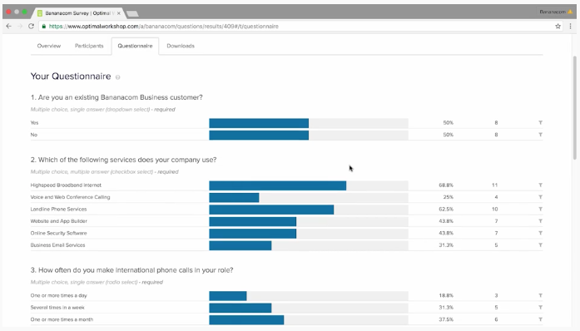
Optimal - Questions
Rétroaction quantitative et qualitative
Analyse en ligne ou téléchargement des données dans Excel
Études autonomes
Études préalables ou postérieures
Notes:
You can set up questions to provide quantitative and qualitative feedback and online links can be easily shared
Results can be analyzed online or you can download them to excel for additional manipulation of data
You can have it as a standalone study or as a pre-study questionnaire or post-study follow-up.

Slide 41
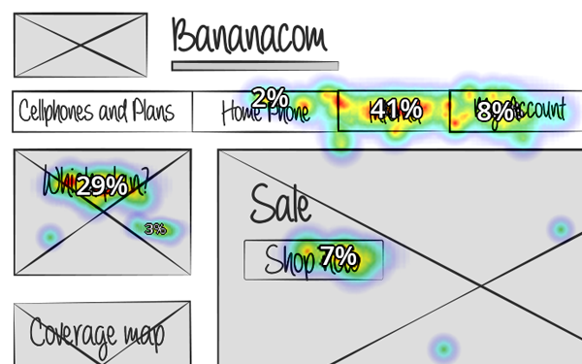
Optimal – ESSAI DE CONCEPTION (CHALKMARK)
Outil d’essai de premier clic
Étiquettes d’essai et positionnement des éléments de la conception
Résultats sous forme d’achèvement de tâches et de cartes thermiques
Notes:
First-click testing is useful to get more gut reactions for designs. There are some limitations with this because this shows the users a static image, from which they are asked to click on the location they think would help them complete a task.
It is useful to test labels as well as the placement of design elements on screen
Results are in the form of task completion, based on identified areas for success, and heatmaps that give you insights into the effectiveness and efficiency of designs to enable task completion.

Slide 42
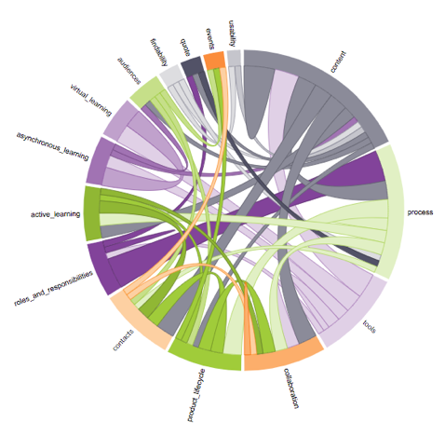
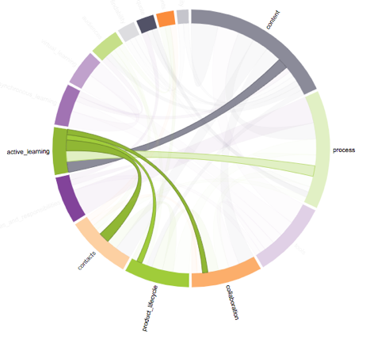
Optimal - RecadrAGE
Saisir/enregistrer les observations
Étiquetage
Aperçu qualitatif des données quantitatives
Créer des thèmes
Utiliser des visualisations pour chercher de l’information
Notes:
Reframer is a good tool to capture and record observations. The downside is that you need to be online to be able to use it.
The tagging is a good feature and you can create tag groups, and colour code them as well to help with organizing your qualitative data
When you tag your qualitative data you can then start to create quantitative views of it in terms of how frequently certain tags appear.
In addition, you can create themes based on groupings of tags, giving you further insights and also allowing you to get a sense for what is being said or captured within those themes.
The tool also offers visualization tools such as the chord diagram that can help you insights about how different tags are connected, so that you can build additional themes and look for further insights.

Slide 43
Ressources

Slide 44

QUELQUES ressources
ISO 9241-11 Ergonomie de l’interaction homme-système
Think Like A UX Researcher par David Travis et Philip Hodgson
Outil de calcul de la taille d’échantillon
Notes:
ISO 9241-11 Ergonomics of human-system interaction (https://www.iso.org/obp/ui/#iso:std:iso:9241:-11:ed-2:v1:en)
Sample size calculator (https://www.calculator.net/sample-size-calculator.html?type=1&cl=95&ci=10&ps=500&x=61&y=22)

